Slide 1

AWS PROJECT

Slide 2
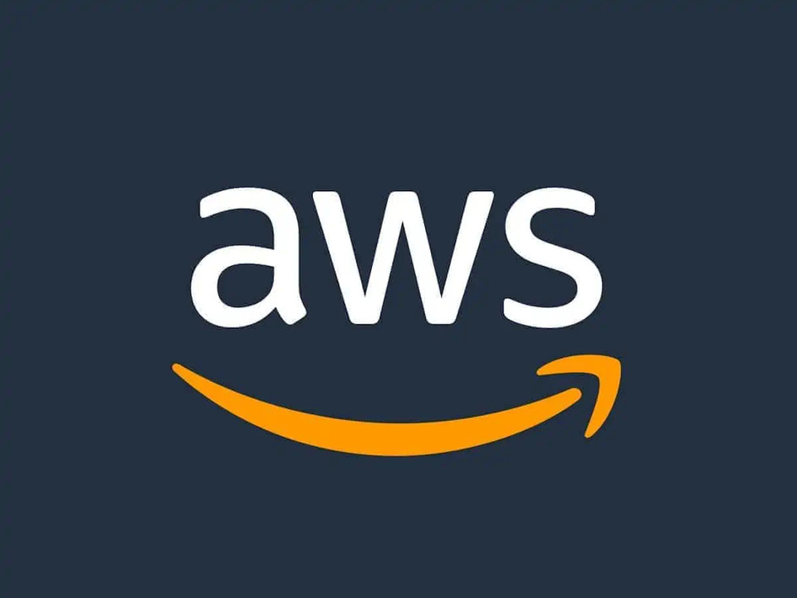
PROJECT TITLE & INTRODUCTION
Title: File Upload & Download Web App on AWS
Goal: Build a cloud-based file sharing application using AWS EC2 and S3.
AWS Services Used
Amazon EC2: Host the Flask web server.
Amazon S3: Store uploaded files.
IAM Role: Grant EC2 access to S3.
VPC + Security Group: Secure network boundaries.

Slide 3
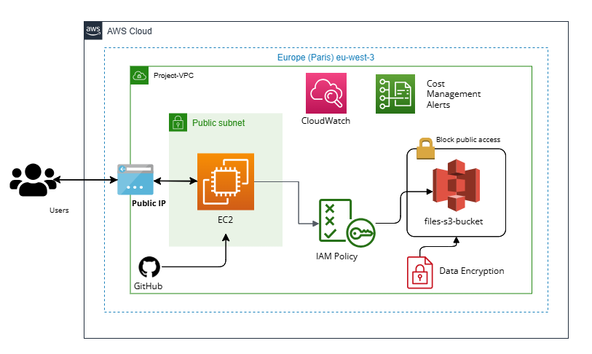
ARCHITECTURE DIAGRAM

Slide 4
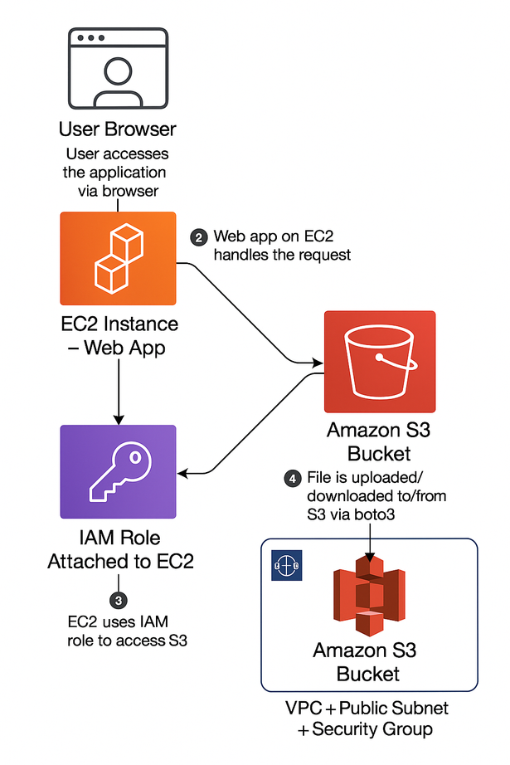
🔹 User Access:
Users access the app via a web browser, sending requests to a backend hosted on an EC2 instance.
🔹 Web App (EC2):
Deployed in a public subnet within a VPC (eu-west-3), secured by a Security Group allowing HTTP and SSH only.
🔹 File Storage (S3):
Files are uploaded/downloaded to/from an S3 bucket via boto3. The bucket is encrypted and public access is blocked.
🔹 IAM & Permissions:
An IAM Role attached to EC2 provides secure, temporary access to S3 with least-privilege policies.
🔹 Monitoring & Cost:
CloudWatch monitors CPU, network, and volume activity. AWS Budgets helps avoid unexpected charges.
🔹 Infrastructure & Git:
App infrastructure is entirely on AWS (Paris region) with code managed via GitHub.
🔹 Roles:
Users: Upload/download files
Developers: Manage AWS resources and deployments
WORKFLOW

Slide 5
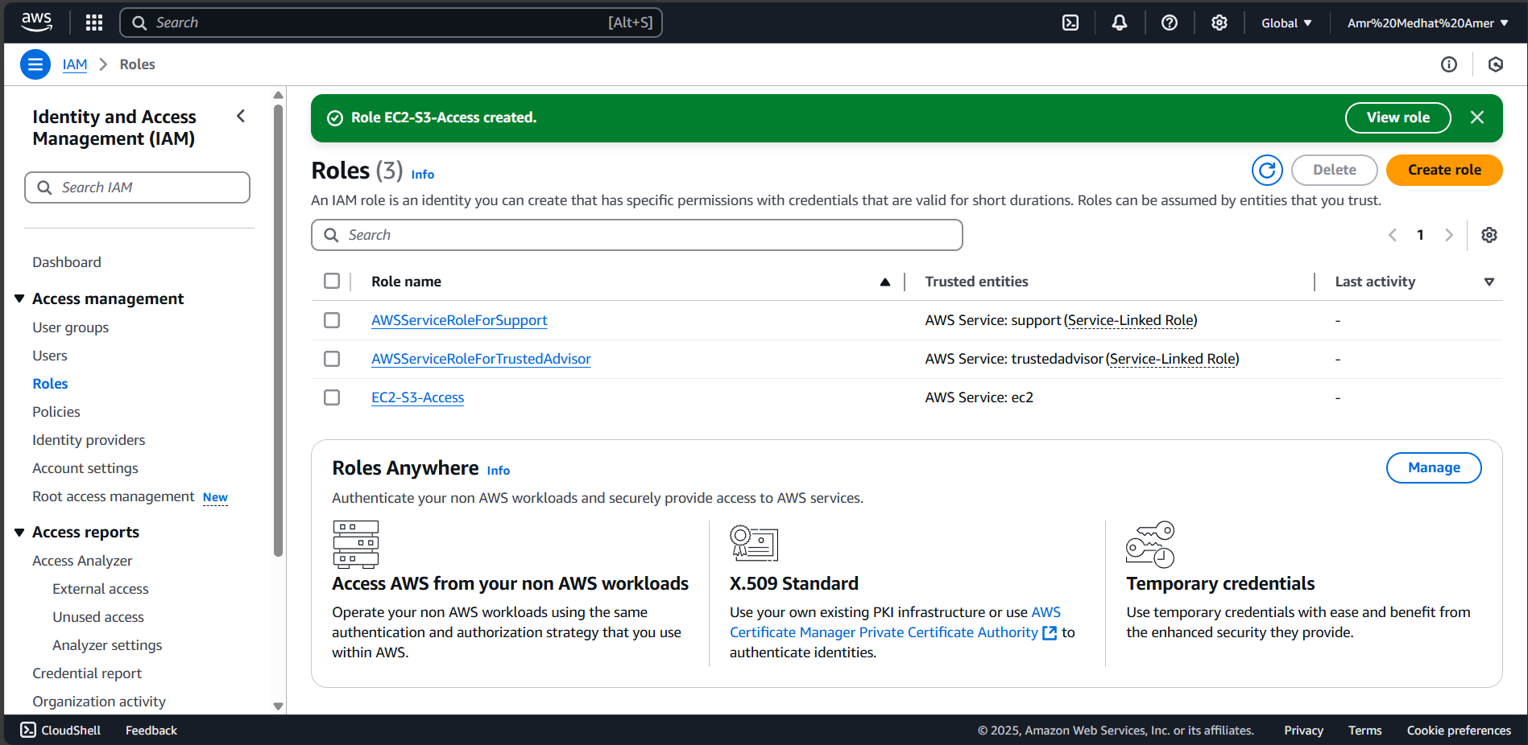
AWS SERVICES: IAM POLICIES
The IAM role attached to EC2 provides secure, temporary access to S3 without storing access keys
Permissions are defined using IAM policies (e.g., AmazonS3FullAccess), enabling the instance to upload, download, or list files from the S3 bucket — securely and at scale

Slide 6
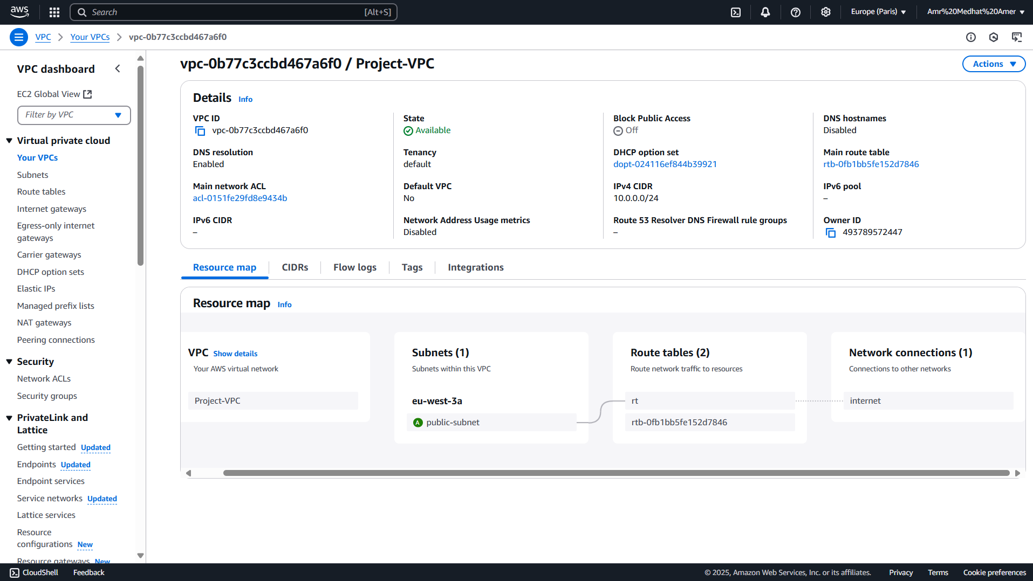
AWS SERVICES: VPC & SUBNET
:"Project-VPC" is configured with
A public subnet in eu-west-3a
An Internet Gateway and Route Table for external access
Security Groups allowing only HTTP (80) and SSH (22)

Slide 7
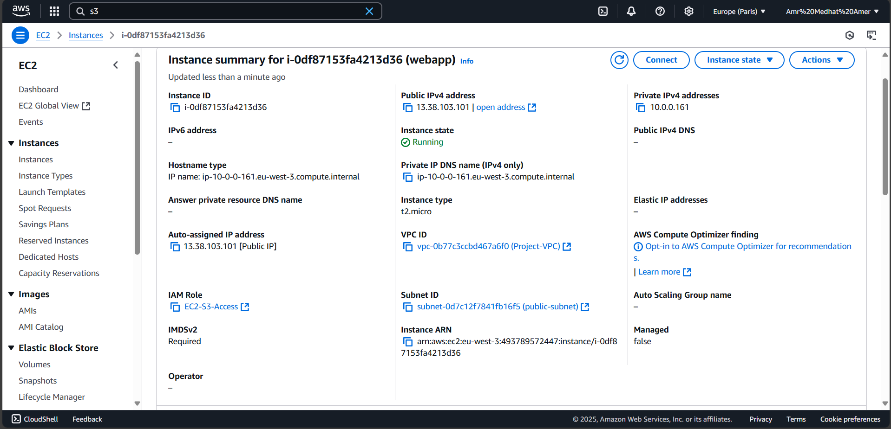
AWS SERVICES: EC2
The EC2 instance is deployed in eu-west-3 (Paris), with type t2.micro and public IP 13.38.103.101
It resides in a public subnet and is attached to the IAM role EC2-S3-Access to securely access Amazon S3

Slide 8
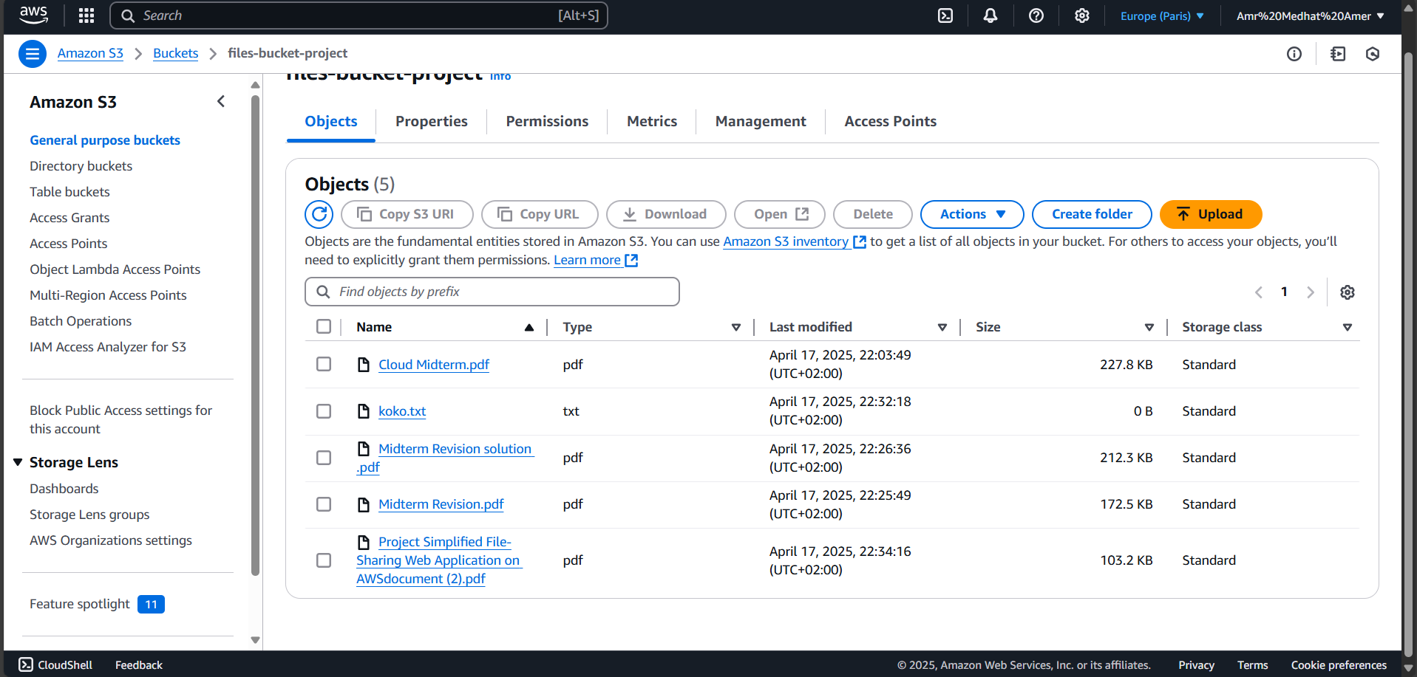
AWS SERVICES: S3 BUCKET
The S3 bucket "files-bucket-project" contains 5 files (PDFs, TXT) with metadata like size and date
Users can upload, download, delete files, and manage permissions and properties via the AWS S3 console

Slide 9
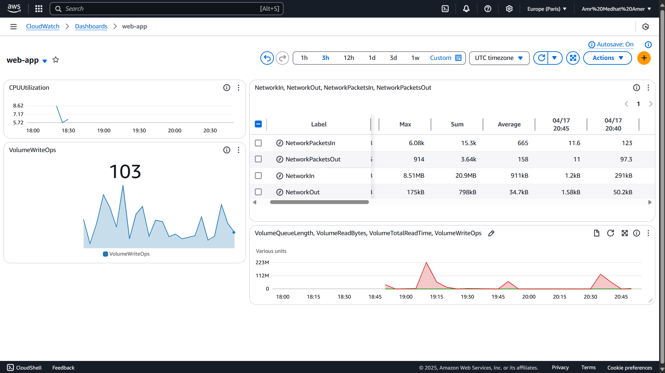
AWS SERVICES: CLOUDWATCH
CloudWatch provides real-time metrics for the app
CPU usage peak: 8.62%
VolumeWriteOps spike: 103
Helps in performance monitoring and identifying infrastructure issue, Monitored via packets in/out

Slide 10
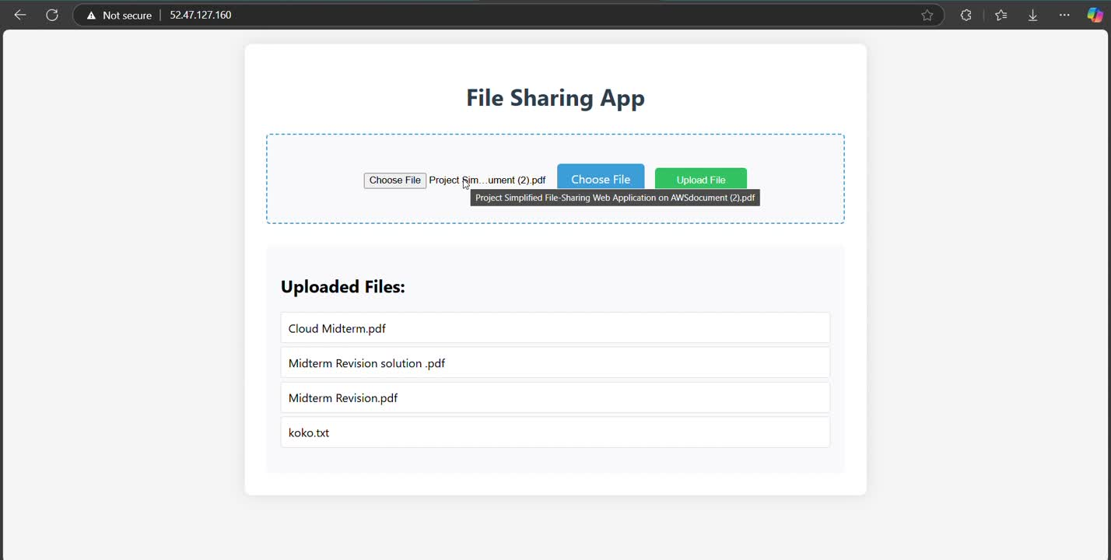
OUR DEMO

Slide 11
ISSUE , HOW WE FIX IT ?
EC2 INSTANCE CONNECT FAILED
We couldn’t connect to the EC2 instance using EC2 Instance Connect in the AWS Console.
🔹 Cause:
The EC2 instance was launched in a public subnet but without a public IPv4 address or proper routing to an internet gateway.
🔹 Solution:
We stopped the instance, assigned a public IP, and ensured the subnet was associated with a route table that had a route like 0.0.0.0/0 → Internet Gateway. We also allowed SSH access (port 22) in the security group.

Slide 12
ISSUE , HOW WE FIX IT ?
PIP3 NOT FOUND ON EC2
Problem:
After launching the EC2 instance and attempting to install dependencies, the command pip3 was not recognized.
🔹 Cause:
The base Amazon Linux 2 AMI did not have pip3 installed by default.
🔹 Solution:
We manually installed pip by running:
bash Script
sudo yum install python3 -y
sudo python3 -m ensurepip --upgrade

Slide 13
OUR ADDITIONS
Integration With Cloudwatch
Display a list of uploaded files in the web app
Apply HTML/CSS styling to improve the UI
IMPLEMENTED ZERO TRUST PRINCIPLES
by applying Least Privilege in EC2 IAM roles and S3 policies:
- IAM role assumptions with limited scope
- Tight security group rules (only required ports)
- S3 bucket access policies allowing access from EC2 only

Slide 14

THANK YOU
CODE & AUTOMATION DEPLOYMENT TERAFFORM
OUR REPO IN GITHUB

